Slide 1
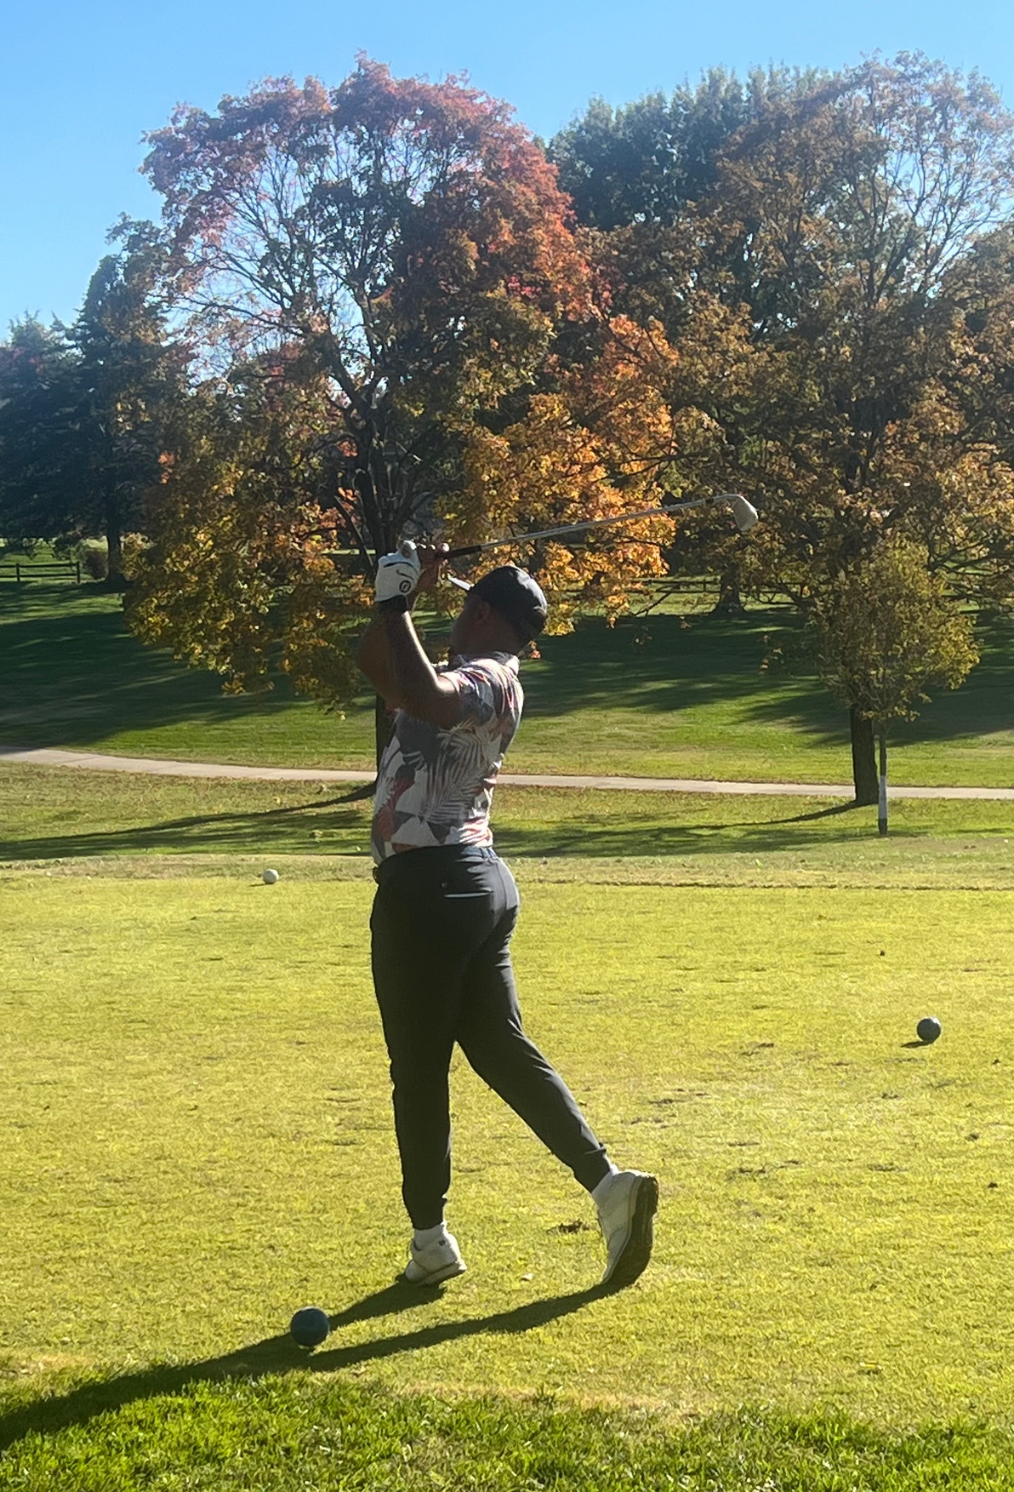
TWIN HILLS NEWS
MONTHLY COURSE NEWS & EVENTS
2026 TOURNAMENT SCHEDULE INSIDE
Your source for all things Twin Hills Golf & Country Club.
March 2026

Slide 2

The clubhouse is buzzing this month, and we’ve lined up a packed schedule designed for one thing: maximum enjoyment. Whether you’re looking to sharpen your skills, meet new friends, or just unwind after a long week, there’s an event with your name on it.
We believe the best part of this club is the community, and it’s just not the same without you in the mix. From low-key mixers to our high-energy signature events, this month is all about getting the most out of your membership.
Take a peek at the following pages to see:
Social Highlights: Dinners, mixers, and themed nights you won't want to miss.
Golf & Greens: Pro Shop and News Updates
Member News: Updates to membership information and policies.
Flip through to find your favorites and get those dates in your diary—we can't wait to see you there!
Twin Hills
News & Events
Page 3
Clubhouse News & Events
Page 5
Events Calendar
Page 8
Pro Shop News & Specials
Page 10
2026 Tournament Schedule
Page 11
Greens Dept. Course News
Page 11
Meet our staff
Need more information? Call us or visit our website
www.twinhillsgolf.net
2

Slide 3
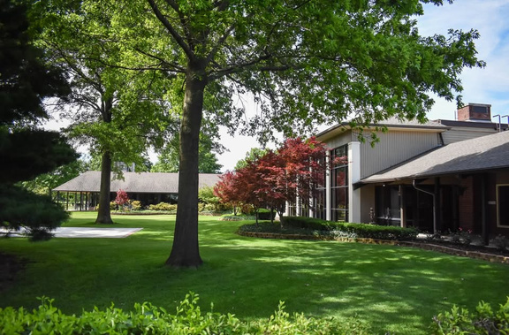
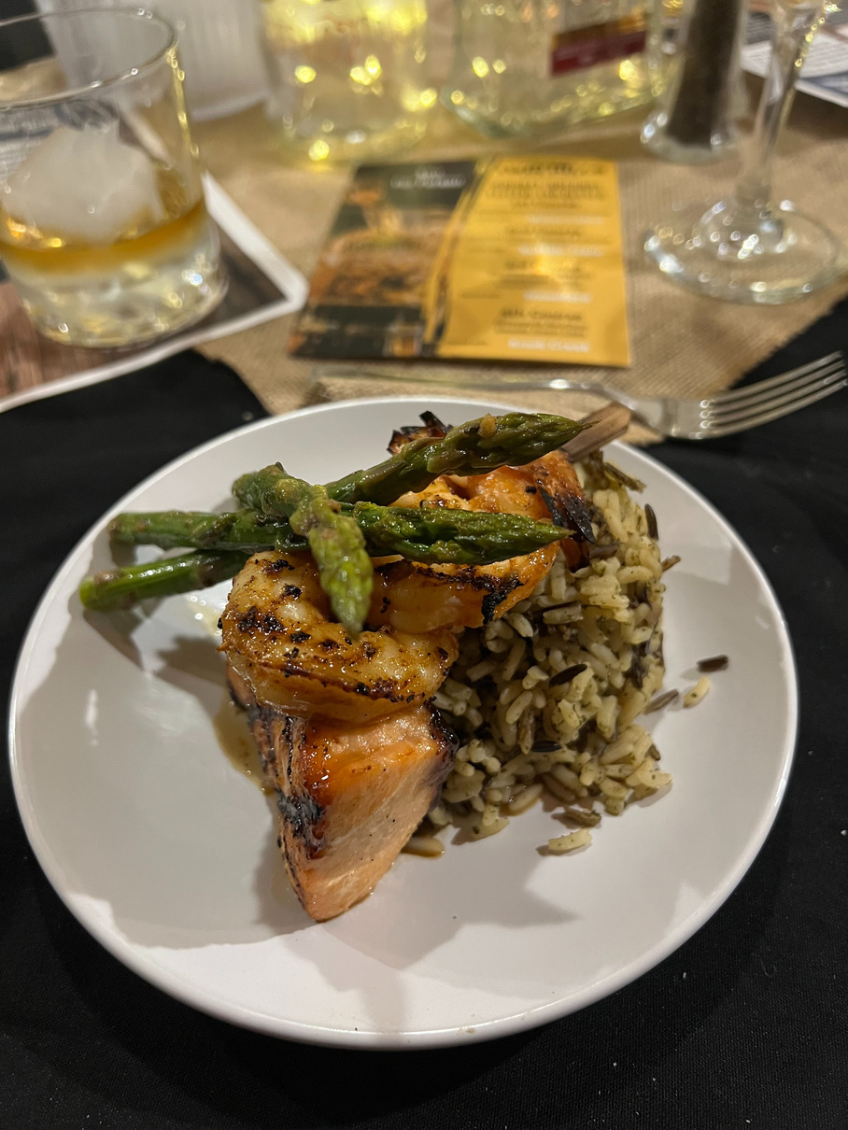
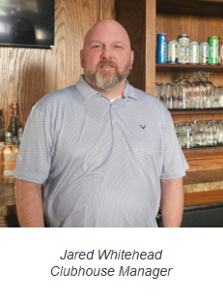
March
Club House
The Clubhouse is Coming to Life! 🥂
As we shake off the final chill of winter and watch the greens start to glow, the action is moving off the course and right into the heart of the clubhouse. March is all about that "spring-forward" energy—longer evenings, brighter days, and a social calendar that’s finally heating up.
We’ve spent the winter months planning a season full of reasons to gather, toast, and celebrate. Whether you’re here for the post-round banter or just looking for a great night out with friends, the clubhouse is the place to be this month.
Flip through to see what’s on deck for our social scene:
Trivia Night: Sharpen your wits and grab a drink for a battle of the brains. No handicap needed for this kind of "course" knowledge!
Bunco Bash: Roll the dice and enjoy some fast-paced fun. It’s the perfect way to catch up with friends and meet new members in a high-energy setting.
Murder Mystery Dinner Club: Put on your detective hat for a night of suspense, secrets, and a fantastic three-course meal. Can you solve the crime before dessert?
The fires are winding down, the patio is calling, and we can’t wait to see the clubhouse full of familiar faces again. Let’s make this season one to remember!
3

Slide 4







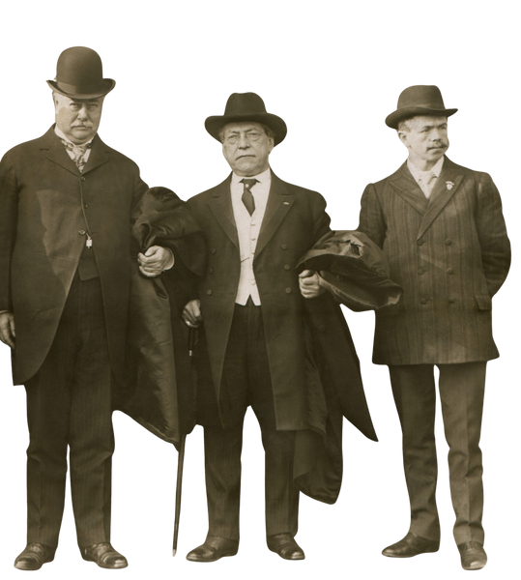
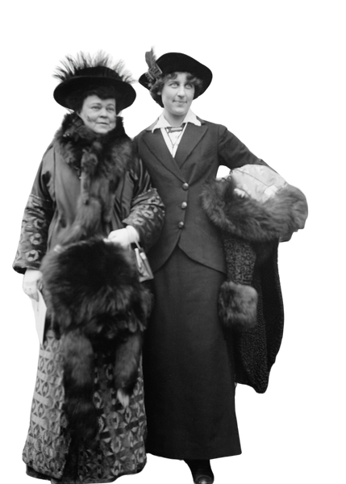









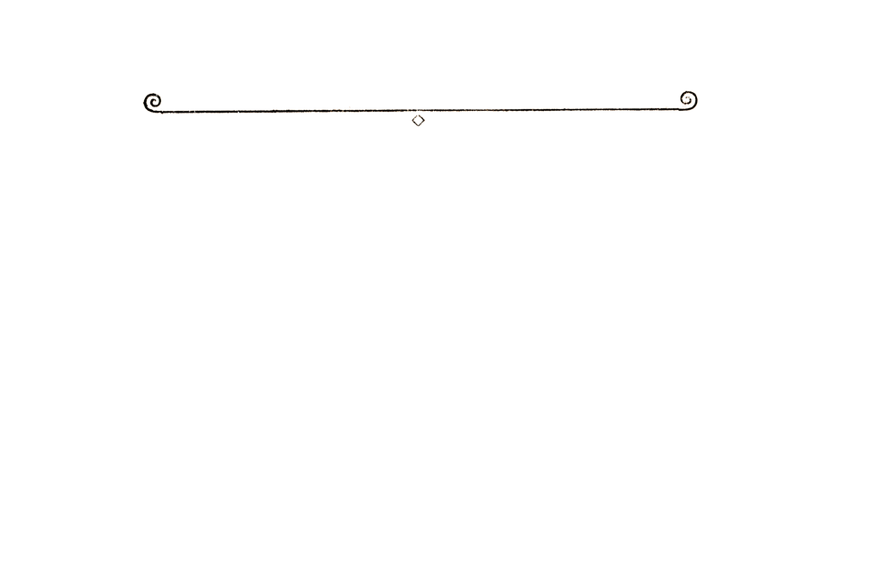




March Events
Death of A Gangster
A 1920's Mafia Marriage Murder Mystery
RSVP ONLY
Scan Here
Dinner
&
Show
Or email
events@twinhillsgolf.net
Presented by
Have you been to a Dinner Club event yet?
&
Period Specific attire encourged but not requierd.
Connor Hamilton
POST CARD
United States
& Canada
One Cent.
For Correspondence.
For Address Only.
Foreign
Two Cents.
Lucky you! You’ve been invited to the Dunn Speakeasy for the wedding of the year! In this “married to the mob” event, you’ll never know who to trust. With the two families merging together, someone is bound to lose power, which means someone else will lose their life! Get on the Golf Cart and solve this case with your fellow detectives.
Dress like the cat’s meow for this mafia wedding! Flapper dresses, zoot suits, feather boas and headbands, pinstriped suits and fedoras are all appropriate. Traditional wedding attire is nifty too!
Menu
Italian Salad
Lettuce with pepperoncini, black olives, croutons, red onion, and tossed in an Italian dressing
Location: Twin Hills Golf & Country Club
Main Course
Choice of 1 Served with Garlic Bread
Big Sghetti
Spaghetti and Meatballs
Alfredo
Alfredo pasta with choice of Chicken or Mushrooms
Date: 3/13/2026
Time: 6:30 pm - Drinks in Jolly Boys
Time: 7:00 pm - Dinner and Show
Cost: $50 per Person -Includes Show & Food
Drinks are seperate - 10$ non-refundable deposit required.
If you haven’t been, You are missing out!
The food is always great, and the drink specials amazing.
And this time - There will be a Murder Mystery Show
Dessert
Tiramisu
4

Slide 5

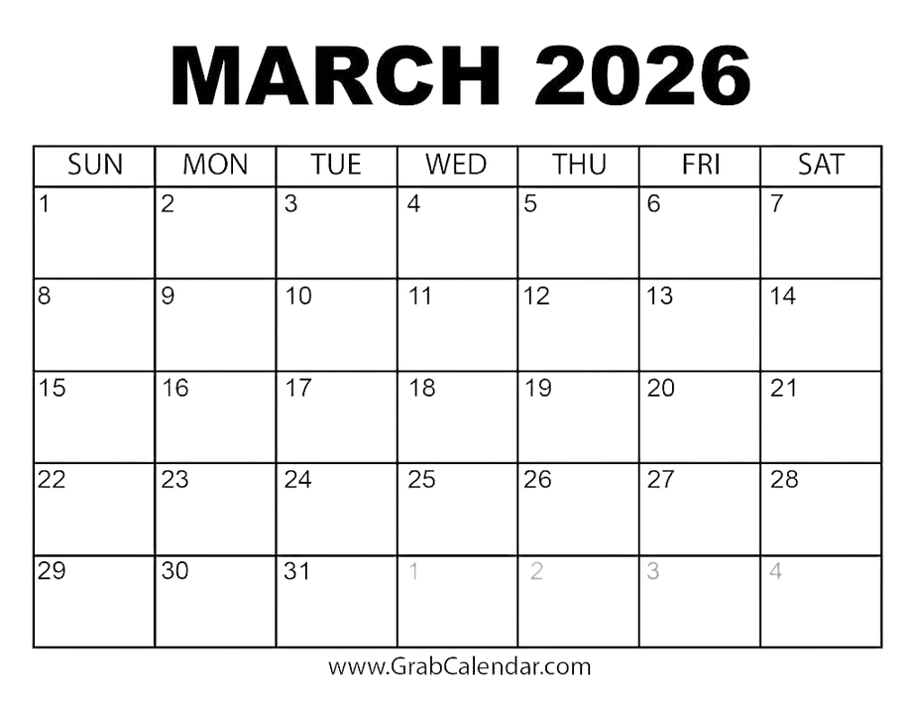
5th - Bunco Game Night - 6:30 PM
8th - Daylight Savings - HOURS CHANGE
13th - Dinner Cub - Murder Mystery Theater - 6:30 PM
14th - Players Grand Slam Event AM
15th - March Madness starts!
17th - Social - Finance - Club Ops - Golf & Greens Committee Meetings
18th - Membership Committee Meeting
19th - Trivia Night - 6:30 PM
25th - Board of Directors Meeting 5:30 PM
28th - 29th - Elite 8 NCAA - Drink Specials in Jolly Boys!
23rd - 27th - Drill & fill Green Aeration
NEW HOURS:
Monday: Closed
Tuesday - Thursday: 10 AM - 9 PM
Friday: 10 AM - 10 PM
Saturday: 7 AM - 10 PM
Sunday: 7 AM - 7 PM
5

Slide 6



Saturday’s in Jolly Boys only
$15
Slam Dunk Special!
Pick 3 Apps
Whiskey Onion rings - Fried pickles & Jalapenos -
Spinach Artichoke Dip -Mozz Sticks - Queso -
Spicy Pretzel Honey Cheese Balls
6
Ask about our Jolly Boys Drink Specials!

Slide 7

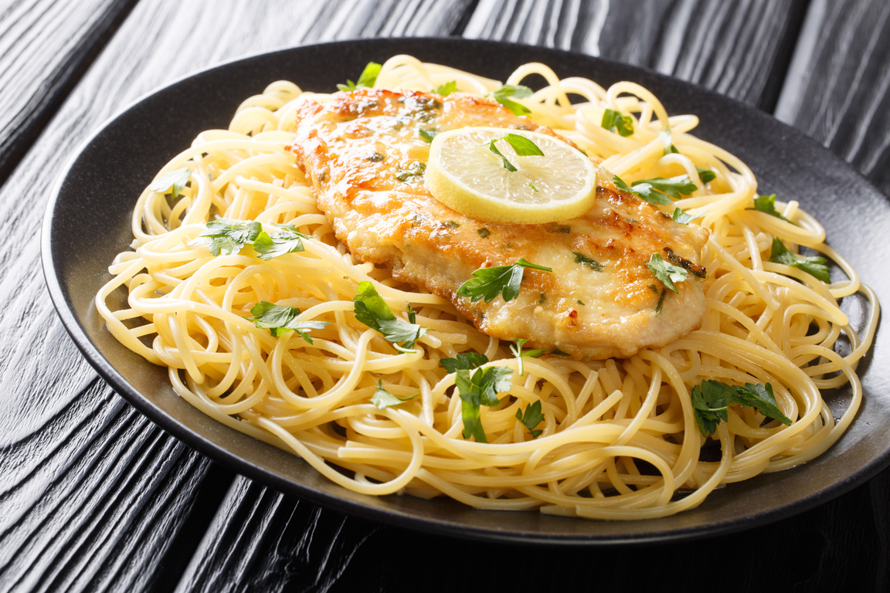
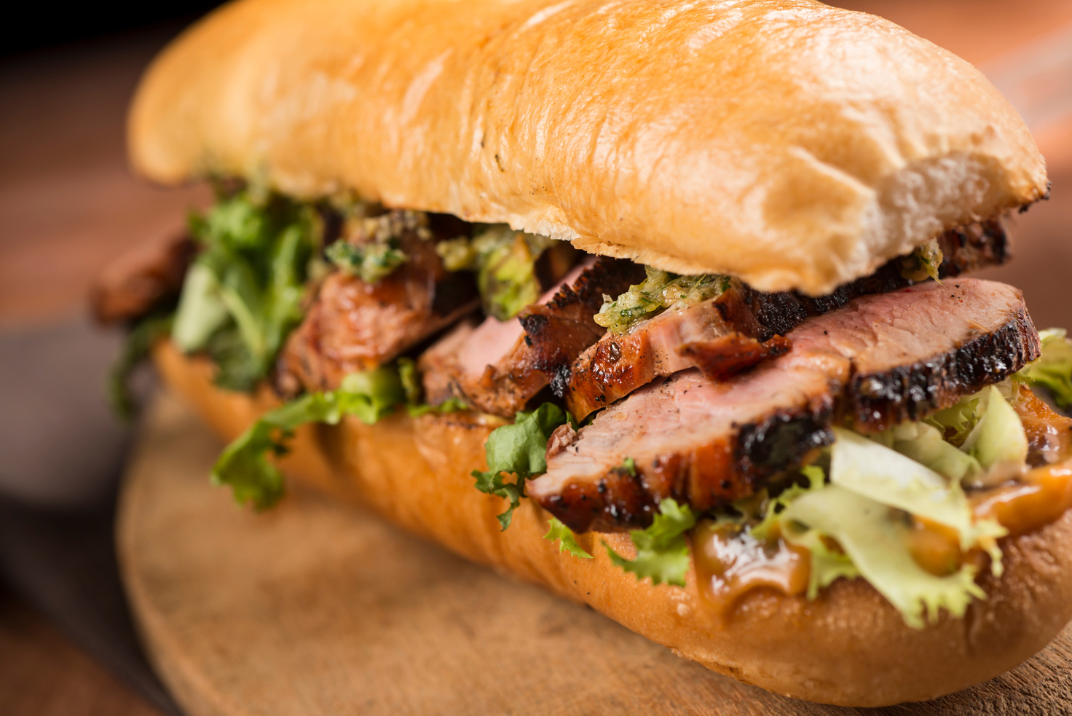
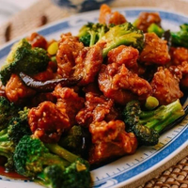
This Month’s Lunch Specials
Tuesdays - Chef Choice
Each week our chef creates a one-of-a-kind special dish, featuring fresh ingredients and bold flavors. The Weekly Special changes every week, so there’s always something new to look forward to—be sure to stop by and see what’s cooking!
Wednesday
Chicken Francese - $16
Fried chicken until golden and served in a tangy, buttery white wine and lemon sauce, served over pasta.
Thursday
Pork Tenderloin Sandwich - $14
A thin-sliced pork tenderloin served on a hoagie bun with mustard cream, topped with swiss cheese, lettuce, tomato and onion. Served with your choice of a side.
Friday
General Chicken - $14
Deep-fried chunks of chicken coated in a glistening, sticky sauce that balances sweet, tangy, and spicy flavors with savory notes of soy, ginger, and garlic, with veggies served over rice. Served with an egg roll.
7

Slide 8


March
Pro Shop
Spring is Just Around the Green! ⛳
The frost is finally retreating, the days are stretching out, and that familiar itch to get back on the fairways is officially here. March marks the turning point we’ve all been waiting for—winter is firmly in the rearview mirror, and the course is waking up just in time for a spectacular season.
We’ve spent the off-season prep-ping a calendar that’s as packed as a Sunday leaderboard. From competitive tournaments to relaxed social scrambles, there are so many ways to enjoy the club and reconnect with your fellow golfers this month.
The Players Grand Slam - Join the fun with this kick-off event for members. Be the first to tee off in our inaugural spring rounds.
Pro-Shop Refresh: New gear and tech to help you shave strokes off your game.
Social Sunsets: Post-round mixers on the patio as the warmer evenings return.
It’s time to dust off the clubs, clean those spikes, and get back to what we do best. Let’s make this season our greatest one yet!
8

Slide 9

March
Specials
XXXXXXXXXXXXXXXXXXXXXXXXX
9

Slide 10

February
28th Saturday- Joplin High Baseball SG 1p.m.
March
14thSaturday- The Players Grand Slam Event -a.m.
23rd-27thMonday- Friday-Drill & Fill Green Aeration
April
4th Saturday -Twin Hills Opening Day – a.m.
6th Monday-Joplin High Invitational – 8:30 a.m. SG
7thTuesday-Fourball (Gross & Net) & Singles Sign Ups (Gross)
9thEvery Thursday- Men’s League Starts 5:30 p.m.
11thSaturday- Masters Grand Slam Event -a.m.
13th Monday-Ascent – 1:00 p.m. SG
27th Monday-Ascent – rain date
2026 Tournament Schedule
August
7th Friday-Arrow Box -RD
11thTuesday-Fourball/Singles Matches
(4th Round August 11th- September 21st)
10th-14th Monday-Friday- AJGA Tournament
21st Friday - Tulsa Sandblasters Practice Round 10-11 am
22nd Saturday - Tulsa Sandblasters – 1:30 p.m. SG
23rd Sunday - Tulsa Sandblasters – 8:30 a.m. SG
24th Monday- PGA Midwest Section Event 18 Holes- 9 a.m.
29th-30thSaturday-Sunday- Twin Hills 36 Hole Stroke Play TT
31st Monday- FCA – 8:30 & 1:30
September
7th Monday- Labor Day Golf Tournament
8thTuesday- COURSE CLOSED
9th Wednesday-20th Annual Ditto/Sapp Memorial Pro-am – 12:30
12th Saturday MOSO 1:30 SG TBD???
13th-15th Sunday-Tuesday-MSSU Ladies Golf Event
17th Thursday - Ronald McDonald House – 8 & 1
19thSaturday- Club Championship TT???
21th Monday - Ronald McDonald House – Rain Date
25th Friday- 34th Harvest Moon Practice Round & Horse Races
26th/27th Saturday/Sunday - 34th Harvest Moon Couples Invitational
28th-2nd Mon-Fri Drill & Fill Green Aeration
October
12th Monday- FCA- Rain Date
15thThursday- ALL LEAGUE PLAY ENDS
16th Friday-GLOW Golf???
18th-20th Sunday-Tuesday MSSU Men’s Golf Tournament
31stSaturday- Closing Day/Supers Revenge Day- a.m
May
1stEvery Friday- Couple Night Starts
4th Monday-Crossland – 1:00 p.m. SG
5thTuesday-Fourball/Singles Matches Begin
(1st Round May 5th-June 1st)
5th Every Tuesday- Ladies League Starts
11th Monday-Crossland RD
12th Tuesday-Rotary/Comm Clinic 1:00
16thSaturday- PGA Championship Grand Slam Event- a.m.
25thMonday- Labor Day Tournament
26thTuesday-COURSE CLOSED
26th Tuesday-Rotary - RD
30th Saturday-Couples Member-Guest- 10 a.m. TT
June
1st Monday-Children’s Miracle- 8am and 1:30 pm SG
2nd -Tuesday- Fourball/Singles Matches
(2nd Round June 2nd- July 6th)
8th -Monday-Children’s Miracle Rain Date
9th Tuesday-17th Annual Joan Thomas Invitational – 8:30 a.m.
20thSaturday- US OPEN Grand Slam Event- a.m.
19th Friday- SMC Practice Round & Horse Races (2:30 p.m.)
20th/21st Saturday/Sunday-Show Me Classic(All Day)
July
4thSaturday- 4th of July Tournament
7thTuesday- Fourball/Singles Matches
(3rd Round July 7th – August 10th)
7th-10th Tuesday-Friday-Junior Golf Camp Session II- 9 a.m.
18thSaturday- The Open Grand Slam Event- a.m.
24th Friday – Invitational practice round & Horse Races (2:30 p.m.)
25th/26th Saturday/Sunday- Invitational 1
31stFriday- Arrowbox – 1 p.m.
10

Slide 11
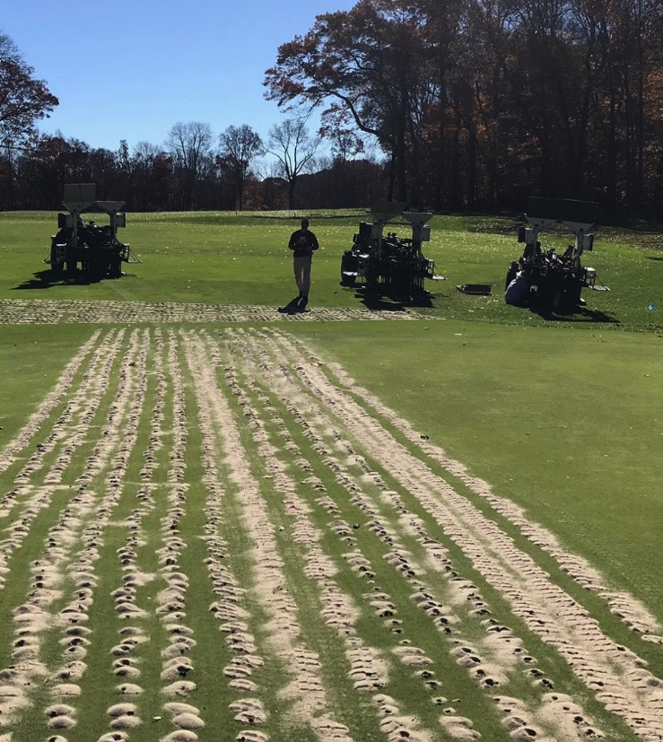

March
Course News
March 23rd - 27th
DRILL & Fill Green Aeration
Keeping Our Greens Great: Drill & Fill Aeration ⛳
If you’ve noticed some extra activity on the course this week, it’s for a very good reason. We are currently performing Drill & Fill aeration, a critical "spa day" for our greens that ensures they stay firm, fast, and healthy all season long.
While we know nobody loves seeing tiny holes on their line, this process is a game-changer for our turf. Unlike standard aeration, the Drill & Fill method goes deeper, bypassing the thatch layer to get sand and nutrients directly into the root zone. This improves drainage, helps the grass breathe, and prevents that "spongy" feel during the wetter spring months.
Why we do it:
Superior Drainage: Keeps the greens playable even after heavy March showers.
Root Health: Encourages deep root growth for heat resistance this summer.
Smoother Surfaces: Once the sand settles, it creates a much more consistent putting surface.
We appreciate your patience while the maintenance crew works their magic. The short-term disruption is a small price to pay for the championship-level conditions we’ll enjoy for the rest of the year!
11

Slide 12
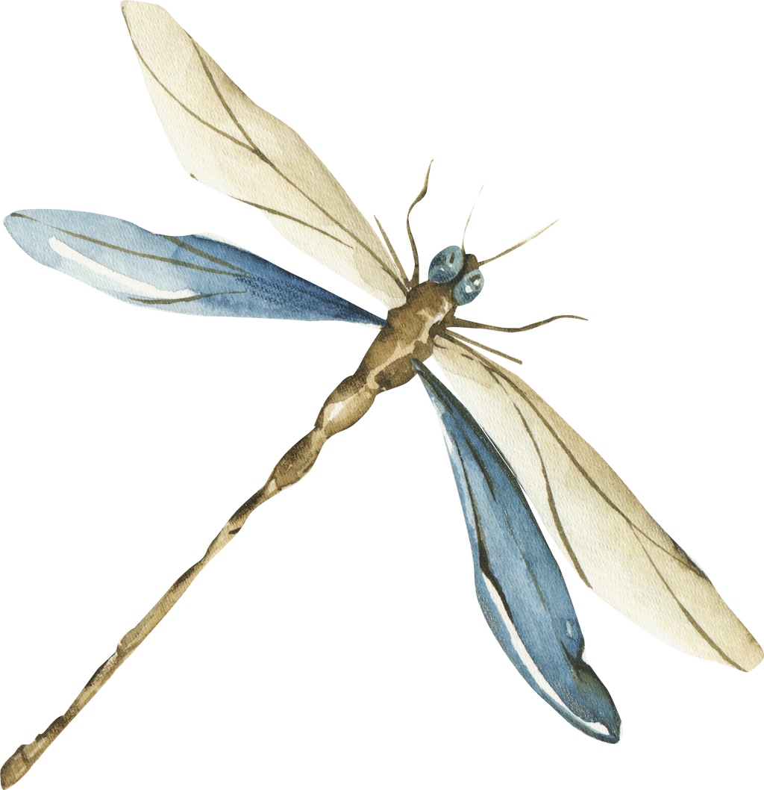

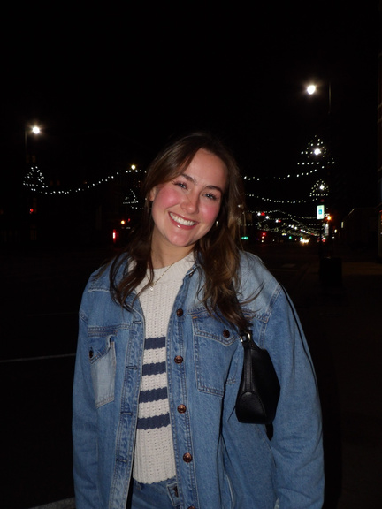


HAVE YOU MET
Lillian
About Me
I have been here for 6 months. I had friends encourage me to interview, also my brother used to be in the Pro Shop. I am the youngest of 4 and enjoying being with family and friends.
Education
Graduating in May from Pitt State
Bachelor's Degree in Psychology
Pursuing a career as a Child Life Specialist in a Children’s Hospital
hobbies
I like to hang out with friends, going to the gym, participating in intramural sporting events, and reading.
12

